Slide 1

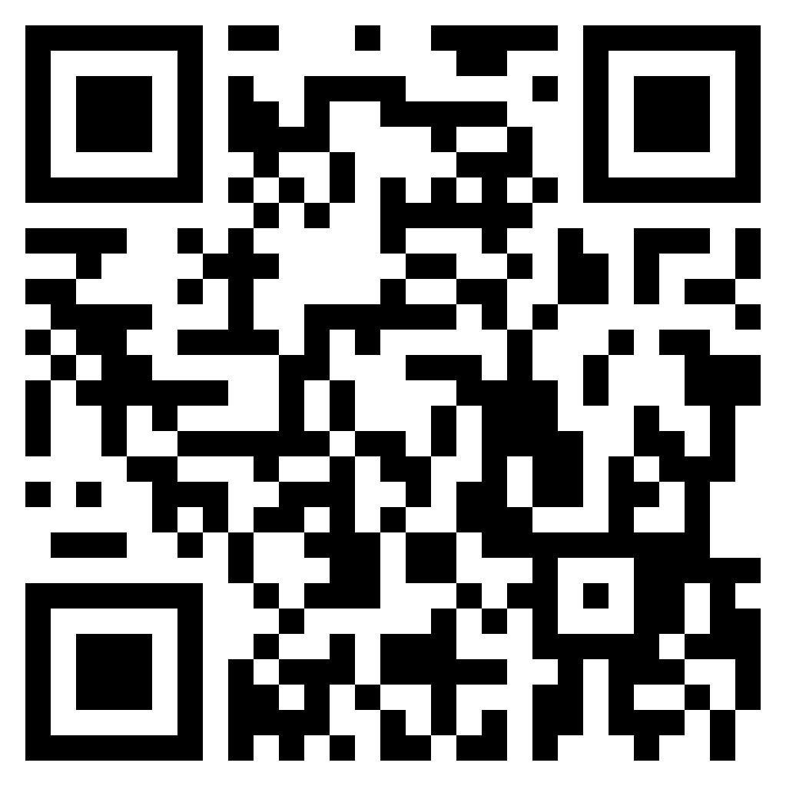
DaBeast Catering LLC
(719) 243-2541
Breakfast
Monte Cristo w/ House Syrup ………………………………. 15
Waffle Breakfast Tacos …... 16
  Made from the freshest plantains
Signature French Toast ….. 13
Queso Frito ……………….. 12
Fried cheese w/ guava marmalade
Lunch / Dinner
Arroz con Pollo Plate …… 14
Rice, beans w/ smoked chicken
Pinchos ……………………. 16
Smoked chicken skewers
Sides
Platanos Maduros .............. 7
Sweet plantains
Tostones …………………… 7
  Crisped plantains
Arroz con Pollo ……………. 6
Beans ………………………. 6
Served
All Day
Desserts
Fried Oreos ……………….. 7
Fried Cheesecake Bites …. 8
Limber De Coco (Ice Cream) …………………………….… 6
Beverages
Guanabana ………………. 6
  Creamy tart drink derived from indigenous fruit ☺
Soft Drinks …………………. 3
  Gatorade, Red Bull, Coke, Sprite, Fanta, Iced Tea, etc.
Water ……………………….. 3
Customer is responsible for any allergen disclosures.
Listed prices are the cash price.
https://dabeastservices.com

